Slide 1

UNIVERSITY INSTITUTE OF ENGINEERING
COMPUTER SCIENCE ENGINEERING
Bachelor of Engineering (Computer Science & Engineering)
Subject Name: Big Data Analytics
Subject Code: 20CST-471
Data visualization techniques
Mapped with CO5
Prepared By:
Er. Ankita Sharma
DISCOVER . LEARN . EMPOWER

Slide 2
Data visualization
Data visualization is a powerful method for presenting complex data in a clear, understandable, and visual format. Effective data visualization techniques help to uncover patterns, trends, and insights within the data. Here are some popular data visualization techniques:
1. Bar Charts:
Purpose: Display and compare the values of different categories.
Example: Comparing sales figures for different products.

Slide 3
3. Pie Charts:
Purpose: Represent parts of a whole, showing the proportion of each category.
Example: Displaying the market share of different products.
4. Scatter Plots:
Purpose: Visualize relationships between two variables.
Example: Plotting points to show the correlation between temperature and ice cream sales.
5. Heatmaps:
Purpose: Display the intensity of data values in a matrix.
Example: Representing website traffic by time and day.
6. Histograms:
Purpose: Show the distribution of a continuous dataset.
Example: Displaying the distribution of student scores in a class.

Slide 4
7. Area Charts:
Purpose: Display quantitative data over a set period and emphasize the magnitude of change.
Example: Showing the growth of website users over a year.
8. Bubble Charts:
Purpose: Visualize three dimensions of data with two on the axes and one represented by the size of markers.
Example: Comparing countries with metrics like GDP, population, and happiness index.
9. Treemaps:
Purpose: Display hierarchical data using nested rectangles.
Example: Representing the composition of a budget with nested rectangles for categories and subcategories.

Slide 5
21. Bullet Graphs:
Purpose: Display performance against benchmarks or goals in a concise and effective manner.
Example: Visualizing sales performance compared to target values.
22. Doughnut Charts:
Purpose: Similar to pie charts, representing parts of a whole, but with a hole in the center.
Example: Displaying the distribution of expenses within a budget.
23. Kiviat Diagrams (Spider Charts):
Purpose: Visualize multivariate data in a radial pattern, with each variable represented by a spoke.
Example: Comparing the performance of individuals or entities across different criteria.

Slide 6
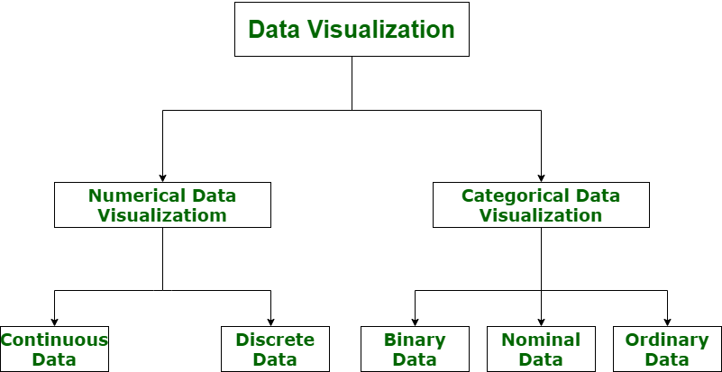

Slide 7
24. Waterfall Charts:
Purpose: Display the cumulative effect of sequentially introduced positive or negative values.
Example: Showing the breakdown of revenue changes, including positive and negative contributions.
25. Sunburst Charts:
Purpose: Display hierarchical data in a circular form, with rings representing different levels.
Example: Representing organizational structures or nested categories.
26. Violin Plots:
Purpose: Combining aspects of box plots and kernel density plots to visualize the distribution of data.
Example: Comparing the distribution of test scores across different groups.
27. Bullet Graphs:
Purpose: Display performance against benchmarks or goals in a concise and effective manner.
Example: Visualizing sales performance compared to target values.

Slide 8
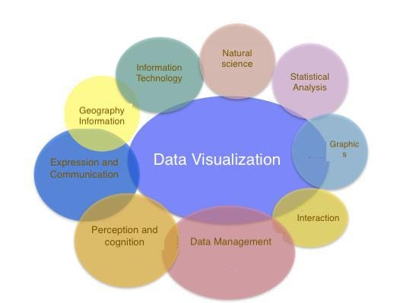

Slide 9
29. Chord Diagrams:
Purpose: Display relationships between data points in a circular layout.
Example: Showing connections between different departments in an organization.
30. Pareto Charts:
Purpose: Combining bar and line charts to display the cumulative contribution of different factors.
Example: Identifying the most significant contributors to a problem.
31. Ridge Plots:
Purpose: Visualize the distribution of a numerical value across different categories.
Example: Displaying the distribution of income levels across various professions.
32. Radial Bar Charts:
Purpose: Represent data in a circular pattern with bars extending from the center.
Example: Showing the distribution of expenses over a year, with each month represented by a bar.

Slide 10
Thankyou

